Slide 1
Visualization I
LECTURE 8
Visualizing distributions and KDEs
Data Science, Fall 2023 @ Knowledge Stream
Sana Jabbar

Slide 2
Goals for this Lecture
Reviewing and concluding regex
Understand the theories behind effective visualizations and start to generate plots of our own
The necessary "pre-thinking" before creating a plot
Python libraries for visualizing data
Lecture 8, Fall 2023

Slide 3
Agenda
Regex
Regex review and regex functions
Visualization
Goals of visualization
Visualizing distributions
Kernel density estimation
Lecture 8, Fall 2023

Slide 4
Regex Review and regex Functions
Regex
Regex review and regex functions
Visualization
Goals of visualization
Visualizing distributions
Kernel density estimation
Lecture 8, Fall 2023

Slide 5
Review: regex
Operation | Order | Example | Matches | Doesn’t match
concatenation (consecutive chars) | 3 | AABAAB | AABAAB | every other string
or, | | 4 | AA|BAAB | AA BAAB | every other string
* (zero or more) | 2 | AB*A | AA ABBBBBBA | AB ABABA
group (parenthesis) | 1 | A(A|B)AAB | AAAAB ABAAB | every other string
 |  | (AB)*A | A ABABABABA | AA ABBA
The regex order of operations. Grouping is evaluated first.

Slide 6
Review: regex
Operation | Example | Matches | Doesn’t match
any character (except newline) | .U.U.U. | CUMULUS JUGULUM | SUCCUBUS TUMULTUOUS
character class | [A-Za-z][a-z]* | word Capitalized | camelCase 4illegal
repeated exactly a times: {a} | j[aeiou]{3}hn | jaoehn jooohn | jhn jaeiouhn
repeated from a to b times: {a,b} | j[ou]{1,2}hn | john juohn | jhn jooohn
at least one | jo+hn | john joooooohn | jhn jjohn

Slide 7
Review: regex
Operation | Example | Matches | Doesn’t match
beginning of line | ^ark | ark two ark o ark | dark
end of line | ark$ | dark ark o ark | ark two
escape character | cow\.com | cow.com | cowscom

Slide 8
Extraction
re.findall(pattern, text)
Return a list of all matches to pattern.
text = "My social security number is 123-45-6789 bro, or actually maybe it’s 321-45-6789.";
pattern = r"[0-9]{3}-[0-9]{2}-[0-9]{4}"
re.findall(pattern, text)
['123-45-6789', '321-45-6789']
A match is a substring that matches the provided regex.

Slide 9
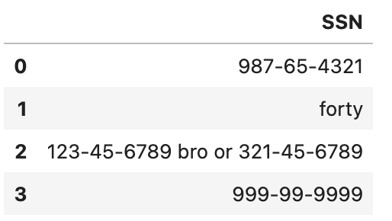
Extraction
re.findall(pattern, text)
Return a list of all matches to pattern.
ser.str.findall(pattern)
Returns a Series of lists
text = "My social security number is 123-45-6789 bro, or actually maybe it’s 321-45-6789.";
pattern = r"[0-9]{3}-[0-9]{2}-[0-9]{4}"
re.findall(pattern, text)
df["SSN"].str.findall(pattern)
['123-45-6789', '321-45-6789']
0 [987-65-4321]
1 []
2 [123-45-6789, 321-45-6789]
3 [999-99-9999]
Name: SSN, dtype: object

Slide 10
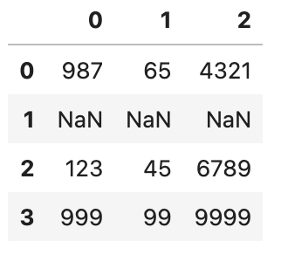
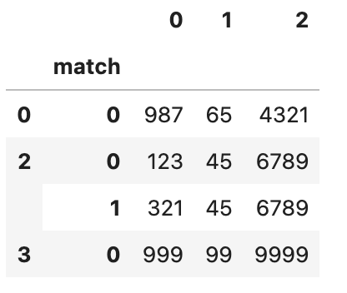
Extraction with Capture Groups
ser.str.extract(pattern)
Returns a DataFrame of each capture group’s first match in the string
ser.str.extractall(pattern)
Returns a multi-indexed DataFrame of all matches for each capture group
pattern_cg = r"([0-9]{3})-([0-9]{2})-([0-9]{4})"
df["SSN"].str.extract(pattern_cg)
df["SSN"].str.extractall(pattern_cg)

Slide 11
Substitution
re.sub(pattern, repl, text)
Returns text with all instances of pattern replaced by repl.
text = '<div><tdvalign="top">Moo</td></div>'
pattern = r"<[^>]+>"
re.sub(pattern, '', text) # returns Moo
Moo
How it works:
pattern matches HTML tags
Then, sub/replace HTML tags with repl='' (i.e., empty string)

Slide 12
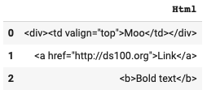
Substitution
re.sub(pattern, repl, text)
Returns text with all instances of pattern replaced by repl.
ser.str.replace(pattern, repl, regex=True )
Returns Series with all instances of the pattern in Series ser replaced by repl.
text = '<div><td valign="top">Moo</td></div>'
pattern = r"<[^>]+>"
re.sub(pattern, '', text) # returns Moo
df["Html"].str.replace(pattern, '')
Moo
How it works:
pattern matches HTML tags
Then, sub/replace HTML tags with repl='' (i.e., empty string)
0 Moo
1 Link
2 Bold text
Name: Html, dtype: object

Slide 13
String Function Summary
Base Python | re | pandas str
s.lower() s.upper() |  | ser.str.lower() ser.str.upper()
s.replace(…) | re.sub(…) | ser.str.replace(…)
s.split(…) | re.split(…) | ser.str.split(…)
s[1:4] |  | ser.str[1:4]
 | re.findall(…) | ser.str.findall(…) ser.str.extractall(…) ser.str.extract(…)
'ab' in s | re.search(…) | ser.str.contains(…)
len(s) |  | ser.str.len()
s.strip() |  | ser.str.strip()
🌟

Slide 14
Goals of Visualization
Regex
Regex review and regex functions
Visualization
Goals of visualization
Visualizing distributions
Kernel density estimation
Lecture 8, Fall 2023

Slide 15


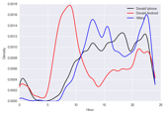
Where are we?
?
Question & Problem
Formulation
Data
Acquisition
Prediction and
Inference
Exploratory Data Analysis
Reports, Decisions, and Solutions
(today)
Data Wrangling
Intro to EDA
Working with Text Data
Regular Expressions
Plots and variables
Seaborn
Viz principles
KDE/Transformations
(Part I: Processing Data)
(Part II: Visualizing and Reporting Data)

Slide 16
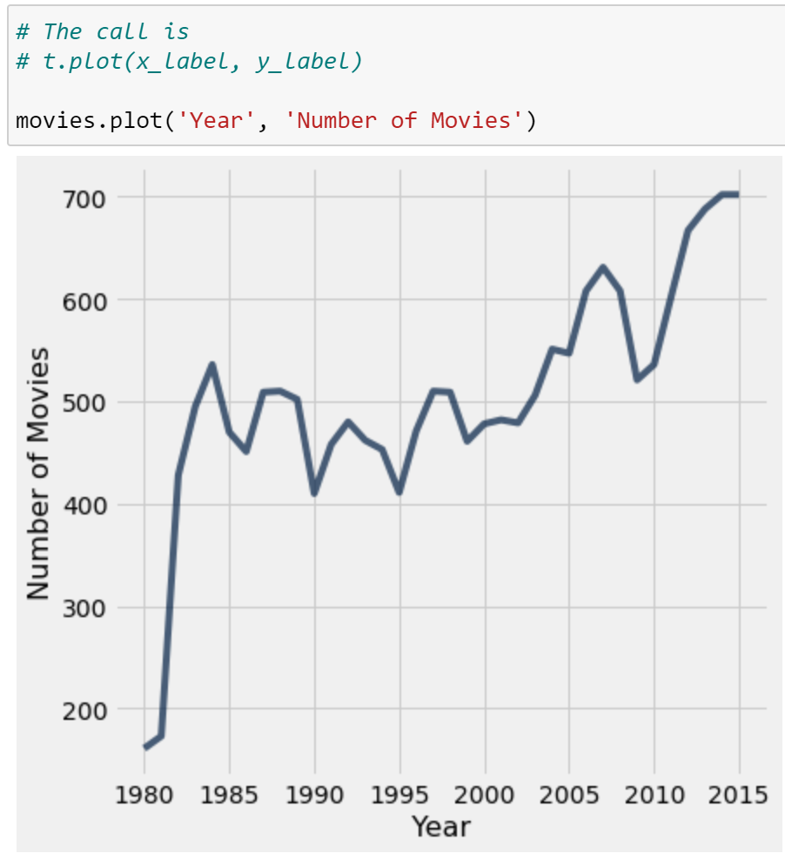
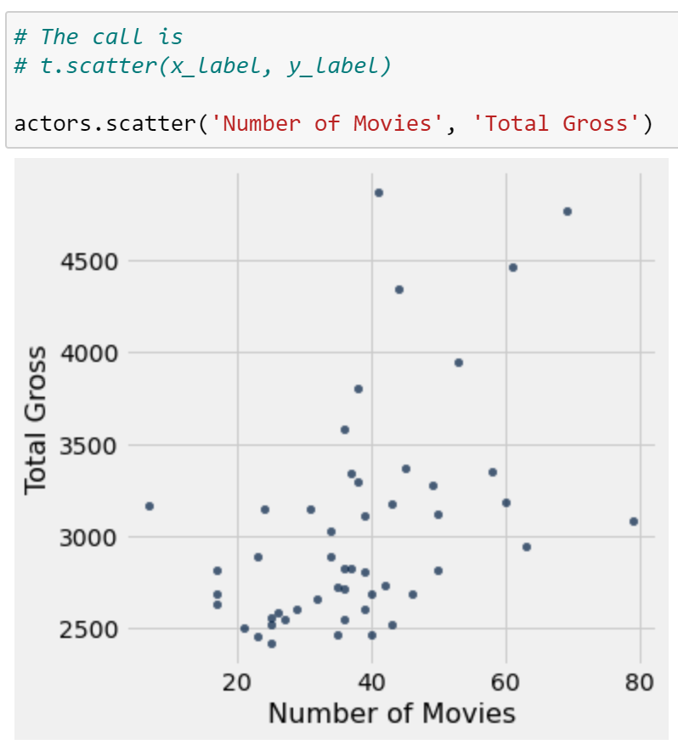
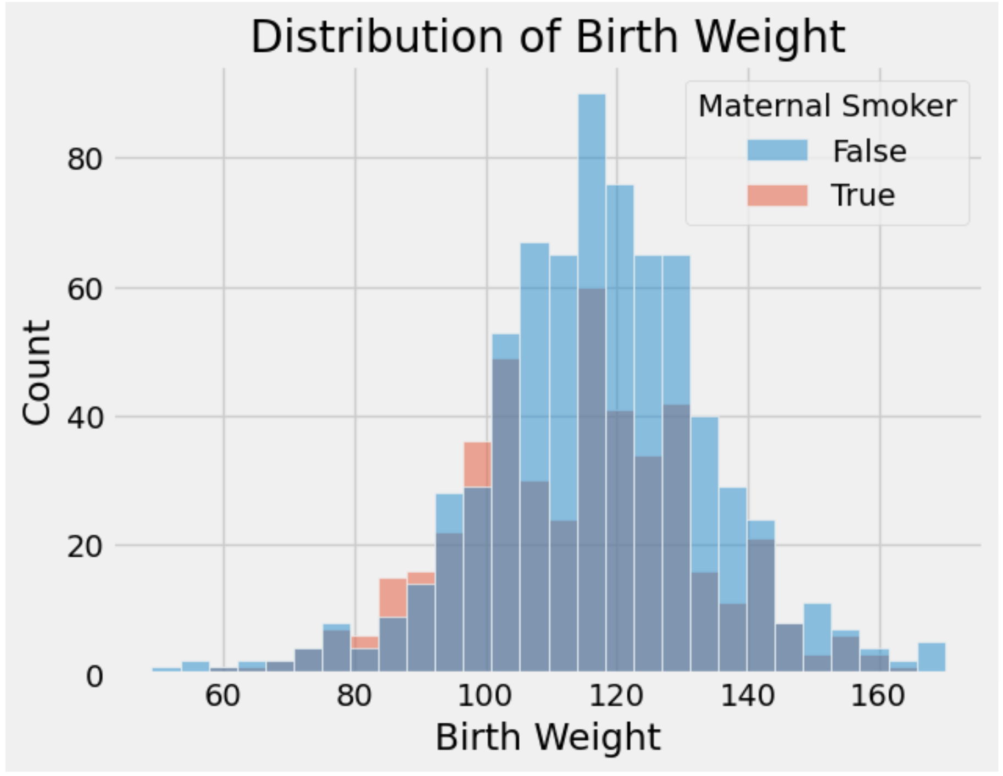
Visualizations in BS (and in Data Science, so far)
You worked with many types of visualizations throughout.
Line plot
Scatter plot
Histogram
What did these achieve?
Provide a high-level overview of a complex dataset.
Communicated trends to viewers.
Notes:
Maps tell one story, time series another.
The importance of one very well-selected metric.
Re-purposing bar charts (great for ranking!) to watch ranks change with time.
Model outputs can be data to be visualized. Data vis can make way for a data dashboard. G

Slide 17
Goals of Data Visualization
Goal 1: To help your own understanding of your data/results.
Key part of exploratory data analysis.
Summarize trends visually before in-depth analysis.
Lightweight, iterative and flexible.
What do these goals imply?
Visualizations aren't a matter of making "pretty" pictures.
We need to do a lot of thinking about what stylistic choices communicate ideas most effectively.
Goal 2: To communicate results/conclusions to others.
Highly editorial and selective.
Be thoughtful and careful!
Fine-tuned to achieve a communications goal.
Considerations: clarity, accessibility, and necessary context.

Slide 18
Goals of Data Visualization
What do these goals imply?
Visualizations aren't a matter of making "pretty" pictures.
We need to do a lot of thinking about what stylistic choices communicate ideas most effectively.
First half of visualization topics in Data Science: Choosing the "right" plot for
Introducing plots for different variable types
Generating these plots through code
Second half of visualization topics in Data Science: Stylizing plots appropriately
Smoothing and transforming visual data
Providing context through labeling and color

Slide 19
Visualizing Distributions
Regex
Regex review and regex functions
Visualization
Goals of visualization
Visualizing distributions
Kernel density estimation
Lecture 8, Fall 2023

Slide 20
Distributions
A distribution describes…
The set of values that a variable can possibly take.
The frequency with which each value occurs for a single variable
Example: Distribution of students across discussion sections in Data Science.
The list of discussion sections (09-12 pm, 02-05 pm, etc.)
The number of students enrolled in each section
In other words: How is the variable distributed across all of its possible values?
This means that percentages should sum to 100% (if using proportions) and counts should sum to the total number of datapoints (if using raw counts).
Let's see some examples.

Slide 21
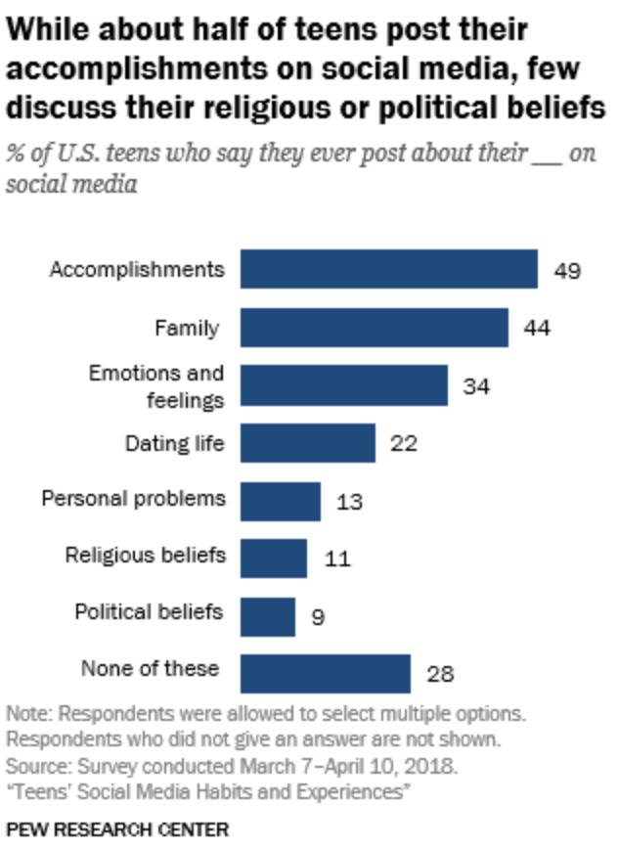
Does this chart show a distribution?
No.
The chart does show percents of individuals in different categories!
But, this is not a distribution because individuals can be in more than one category (see the fine print).
Notes:
https://www.pewresearch.org/internet/2018/11/28/teens-and-their-experiences-on-social-media/

Slide 22
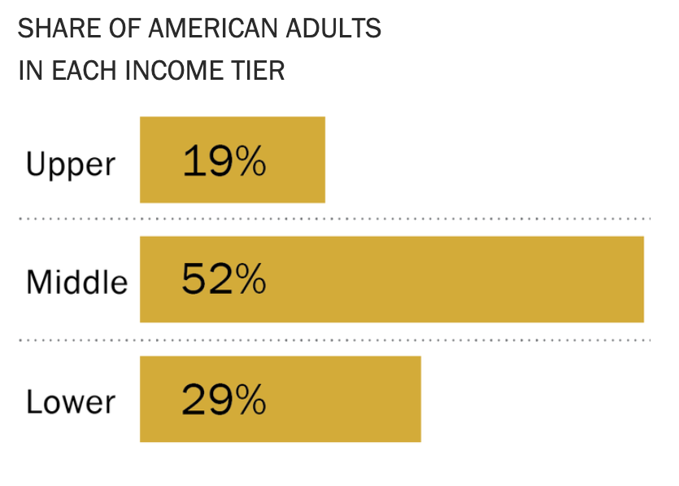
Does this chart show a distribution?
Yes!
This chart shows the distribution of the qualitative ordinal variable "income tier."
Each individual is in exactly one category.
The values we see are the proportions of individuals in that category.
Everyone is represented, as the total percentage is 100%.

Slide 23
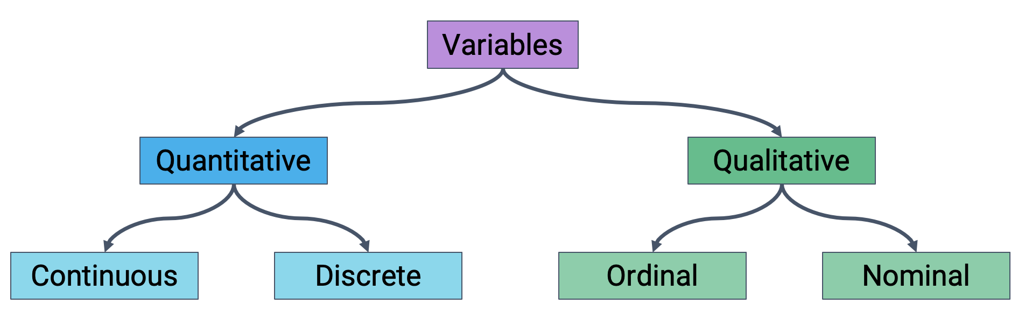
Variable Types Should Inform Plot Choice
Different plots are more or less suited for displaying particular types of variables.
First step of visualization: Identify the variables being visualized. Then, select a plot type accordingly.

Slide 24
Bar Plots: Distributions of Qualitative Variables
Bar plots are the most common way of displaying the distribution of a qualitative variable.
*Sometimes quantitative discrete data too, if there are few unique values.
For example, the proportion of adults in the upper, middle, and lower classes.
Lengths encode values.
Widths encode nothing!
Color could indicate a sub-category (but not necessarily).

Slide 25
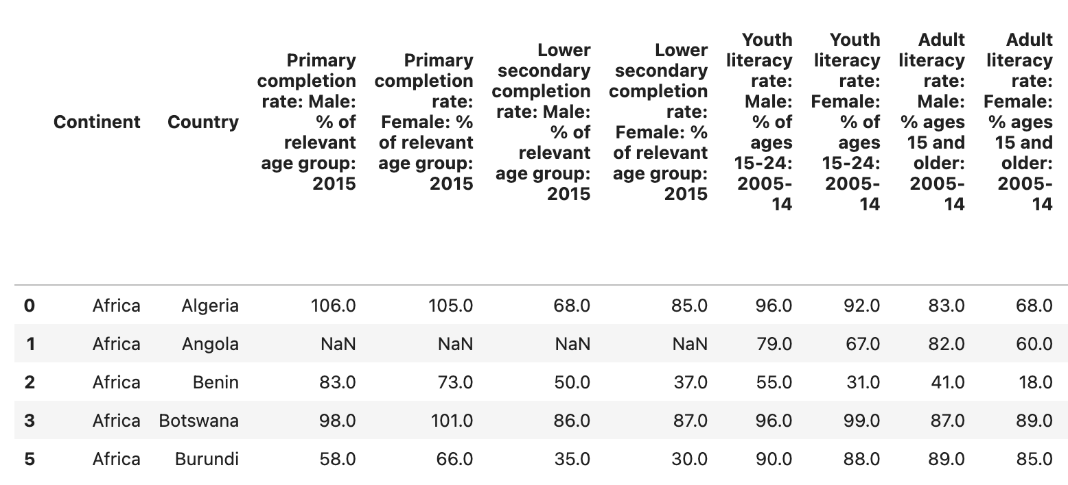
World Bank Dataset
We will be using the wb dataset about world countries for most of our work today.

Slide 26
Generating Bar Plots: Matplotlib
We will mainly use two libraries for generating plots: Matplotlib and Seaborn.
Most Matplotlib plotting functions follow the same structure: We pass in a sequence (list, array, or Series) of values to be plotted on the x-axis, and a second sequence of values to be plotted on the y-axis.
Matplotlib is typically given the alias plt
import matplotlib.pyplot as plt
plt.plotting_function(x_values, y_values)
To add labels and a title:
plt.xlabel("x axis label")
plt.ylabel("y axis label")
plt.title("Title of the plot");

Slide 27
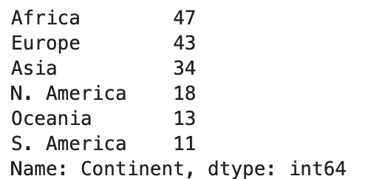
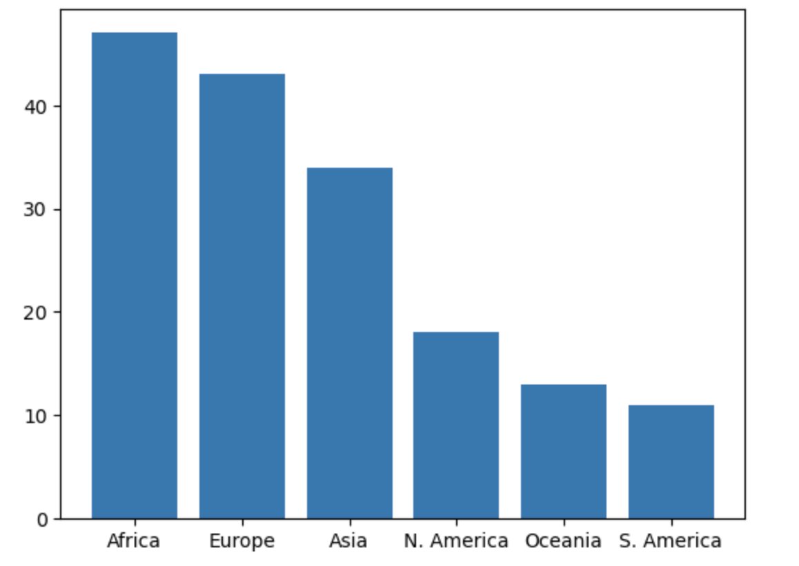
Generating Bar Plots: Matplotlib
To create a bar plot in Matplotlib: plt.bar( )
continents = wb["Continent"].value_counts()
plt.bar(continents.index, continents.values);
x values
y values

Slide 28
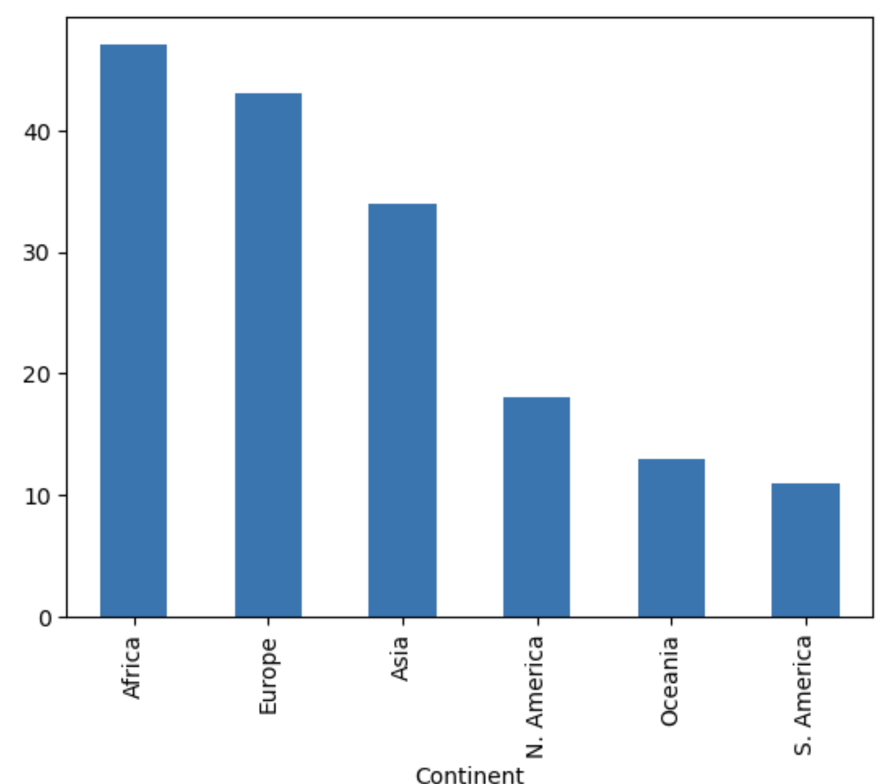
Generating Bar Plots: pandas Native Plotting
To create a bar plot in native pandas: .plot(kind='bar')
wb["Continent"].value_counts().plot(kind='bar')

Slide 29
Generating Bar Plots: Seaborn
Seaborn plotting functions use a different structure: Pass in an entire DataFrame, then specify what column(s) to plot.
Seaborn is typically given the alias sns
import seaborn as sns
sns.plotting_function(data=df, x="x_col", y="y_col")
To add labels and a title, use the same syntax as before:
plt.xlabel("x axis label")
plt.ylabel("y axis label")
plt.title("Title of the plot");

Slide 30
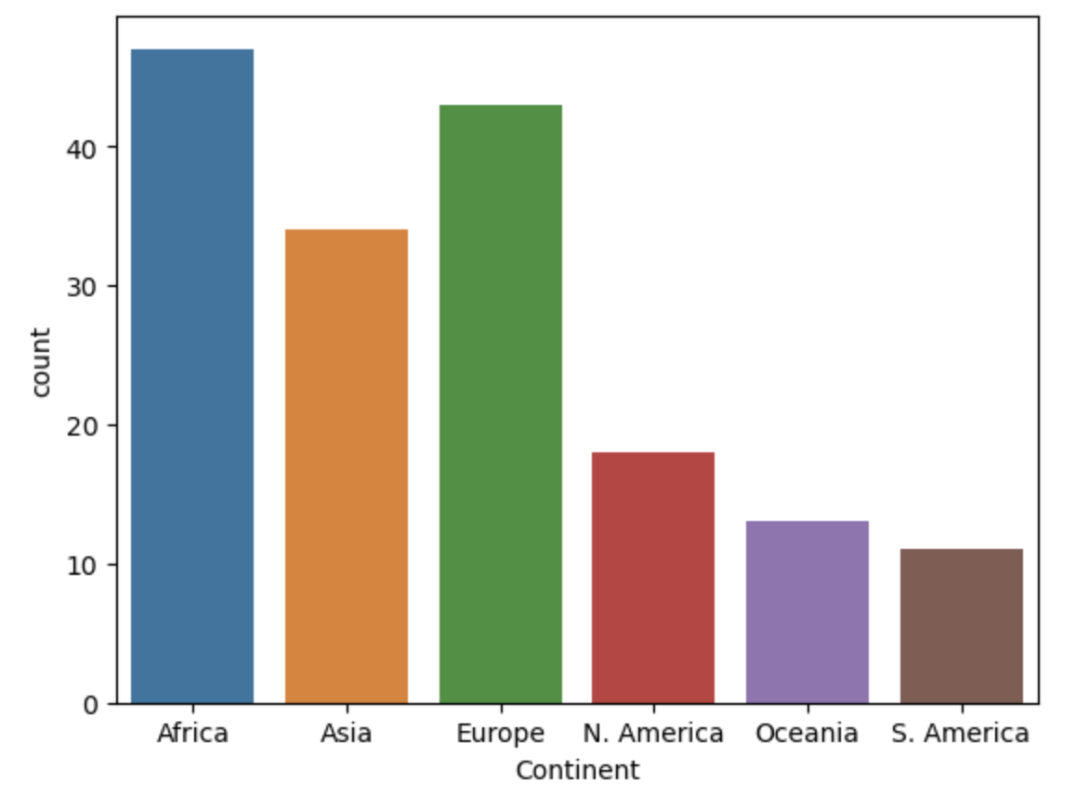
Generating Bar Plots: Seaborn
To create a bar plot in Seaborn: sns.countplot( )
countplot operates at a higher level of abstraction!
You give it the entire DataFrame and it does the counting for you.
import seaborn as sns
sns.countplot(data=wb, x="Continent");

Slide 31
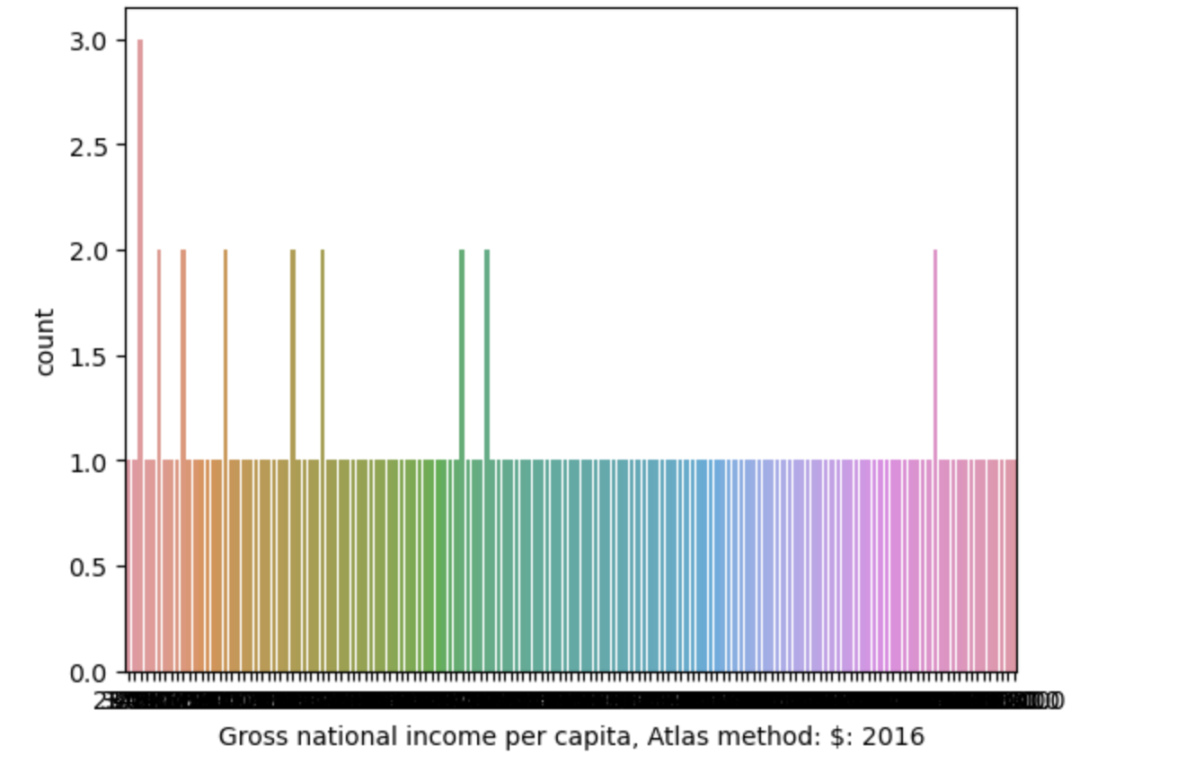
Distributions of Quantitative Variables
Earlier, we said that bar plots are appropriate for distributions of qualitative variables.
Why only qualitative? Why not quantitative as well?
For example: The distribution of gross national income per capita.
A bar plot will create a separate bar for each unique value. This leads to too many bars for continuous data!

Slide 32
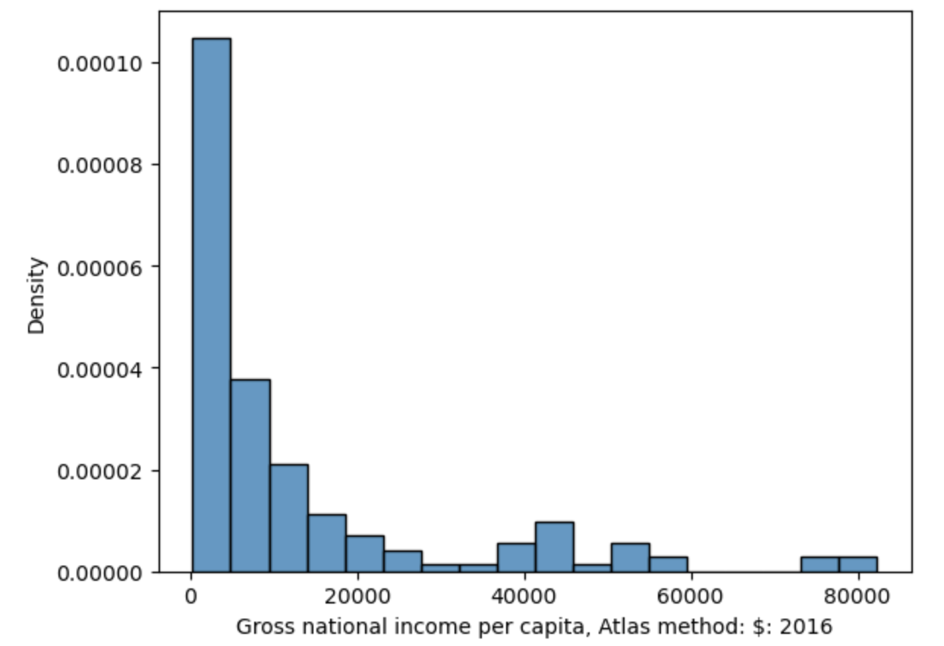
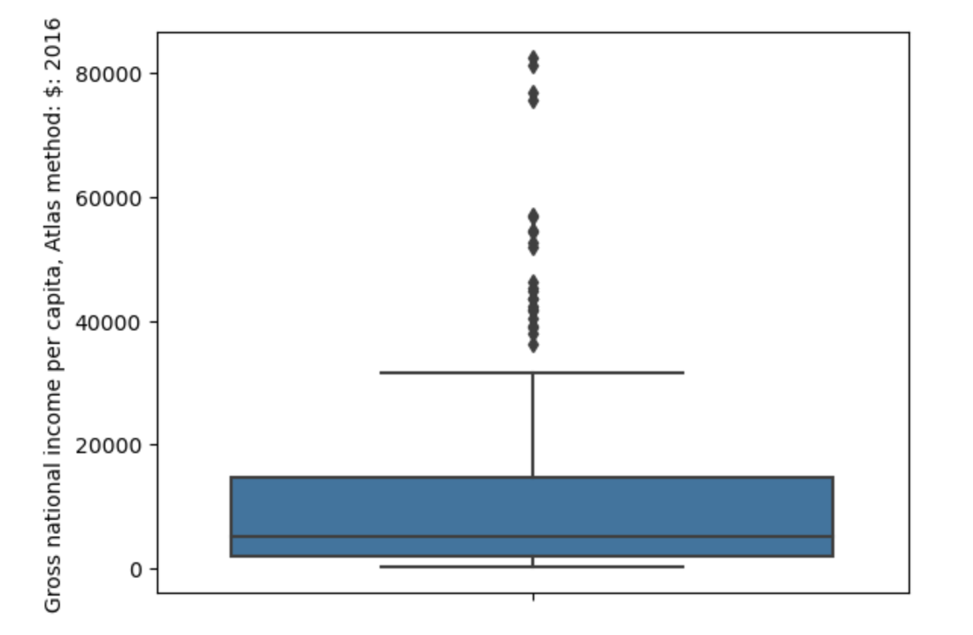
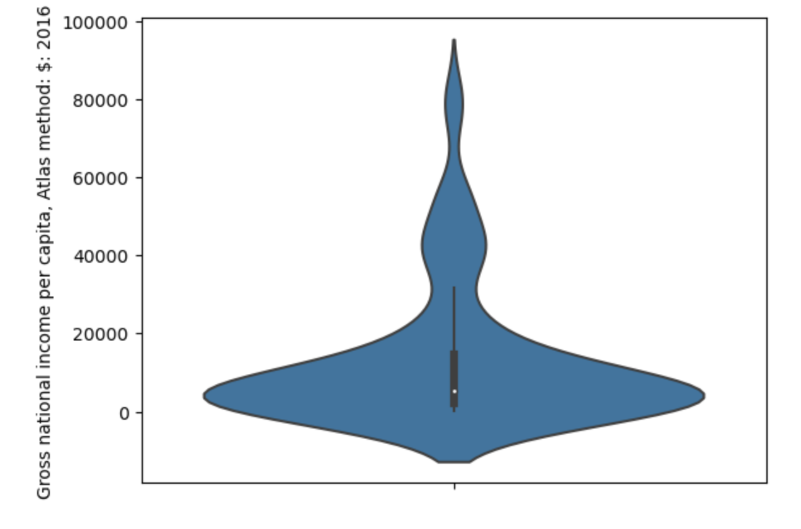
Distributions of Quantitative Variables
To visualize the distribution of a continuous quantitative variable:
Box plot
Violin plot
Histogram

Slide 33
Box plots and Violin Plots
Box plots and violin plots display distributions using information about quartiles.
In a box plot, the width of the box encodes no meaning.
In a violin plot, the width of the "violin" indicates the density of datapoints at each value.
sns.boxplot(data=df, y="y_variable");
sns.violinplot(data=df, y ="y_variable");

Slide 34
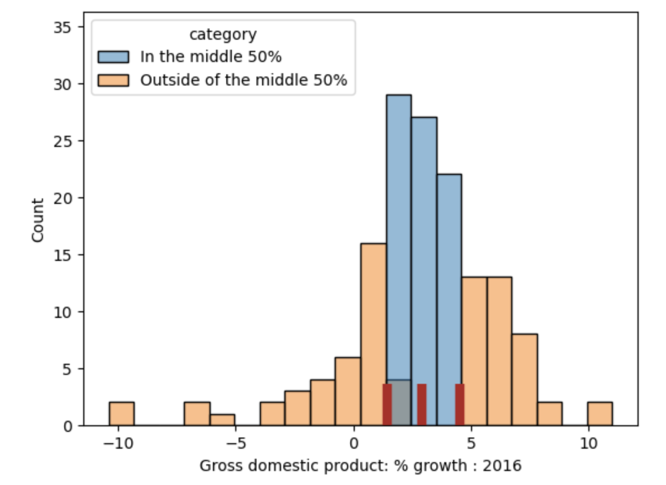
Quartiles
For a quantitative variable:
First or lower quartile: 25th percentile.
Second quartile: 50th percentile (median).
Third or upper quartile: 75th percentile.
The interval [first quartile, third quartile] contains the "middle 50%" of the data.
Interquartile range (IQR) measures spread.
IQR = third quartile – first quartile.
The length of this region is the IQR

Slide 35
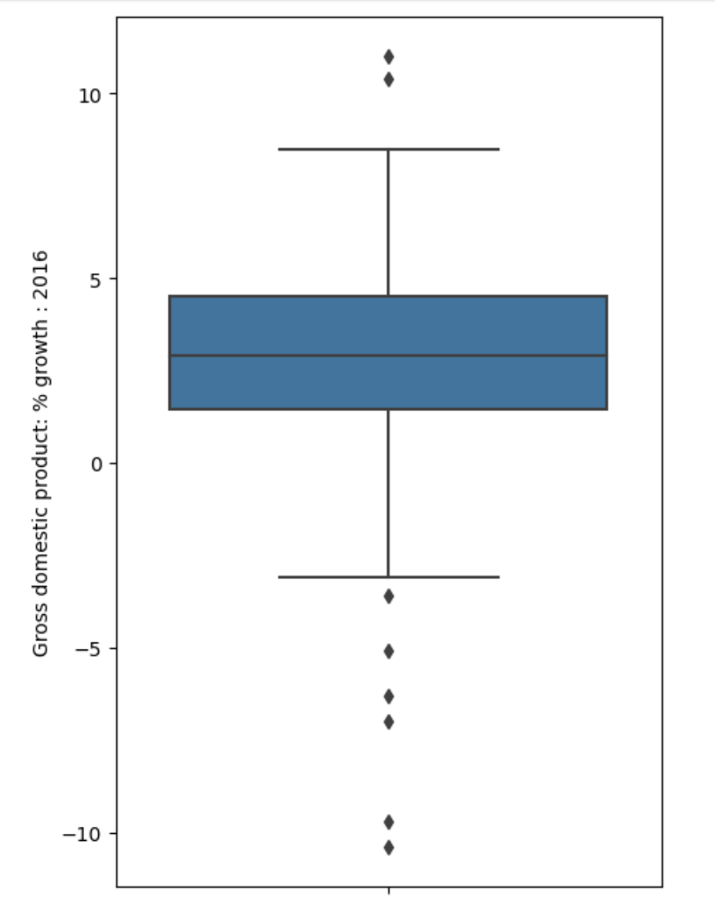
Box Plots
Outliers
Whisker: upper quartile + 1.5*IQR
Third quartile (75th percentile)
Second quartile (median)
First quartile (25th percentile)
Whisker: lower quartile - 1.5*IQR
Outliers
sns.boxplot(data=wb, y="Gross domestic product: % growth : 2016")

Slide 36
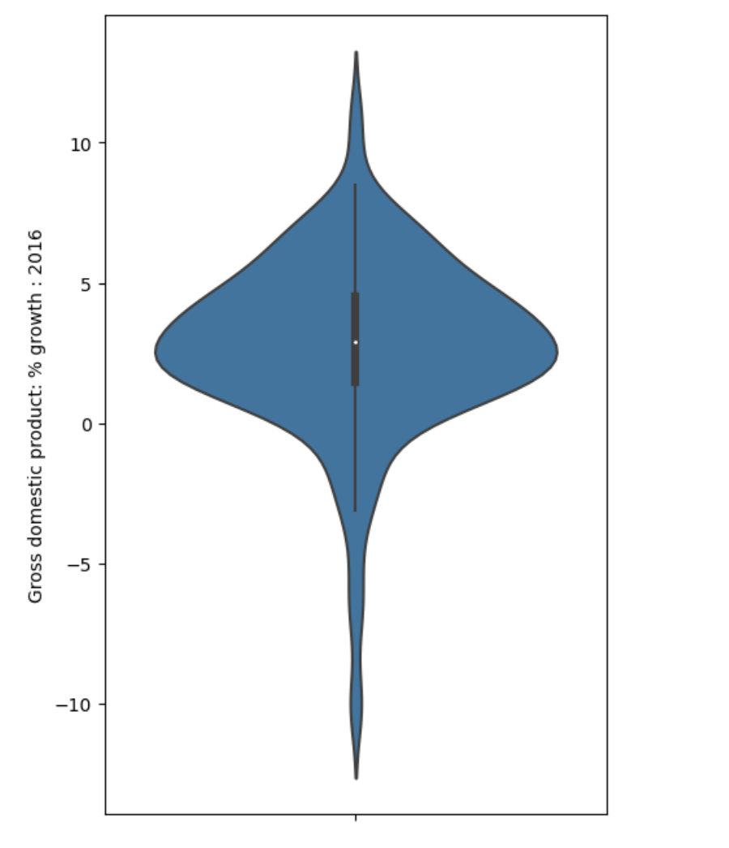
Violin Plots
Violin plots are similar to box plots, but also show smoothed density curves.
The "width" of our "box" now has meaning!
The three quartiles and "whiskers" are still present – look closely.
sns.violinplot(data=wb, y="Gross domestic product: % growth : 2016")

Slide 37
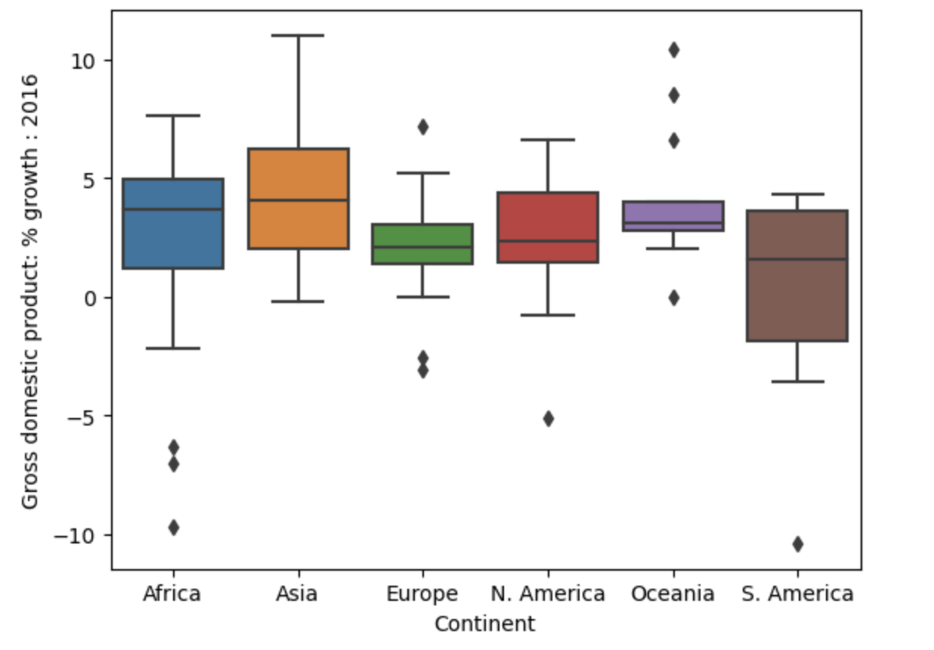
Side-by-side Box and Violin Plots
What if we wanted to incorporate a qualitative variable as well? For example, compare the distribution of a quantitative continuous variable across different qualitative categories.
sns.boxplot(data=wb, x="Continent", y="Gross domestic product: % growth : 2016");
GDP growth: quantitative continuous
Continent: qualitative nominal

Slide 38
Visualization
LECTURE 8
Start Working on Notebooks

